Slide 1





Slide 2
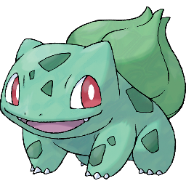
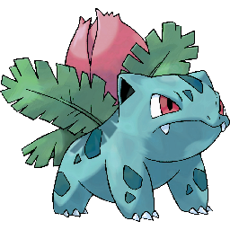
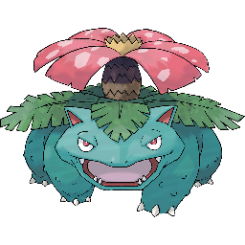

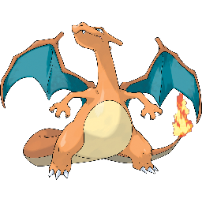
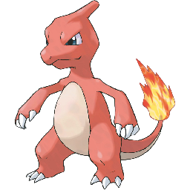

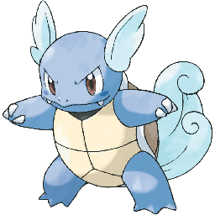
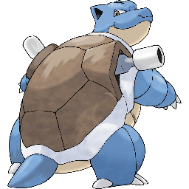
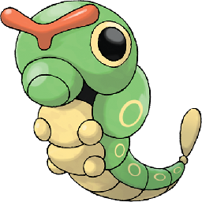
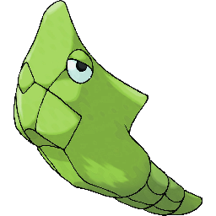

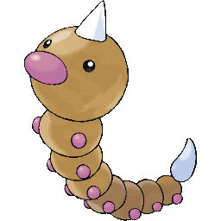
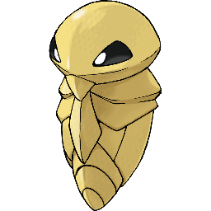
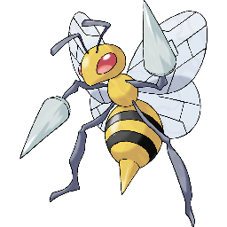
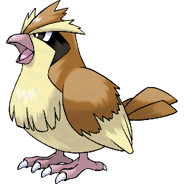
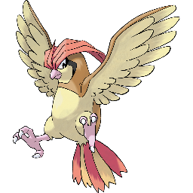
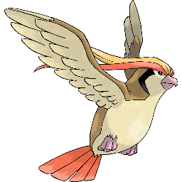
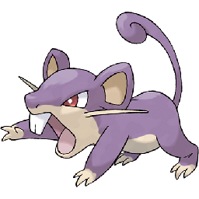

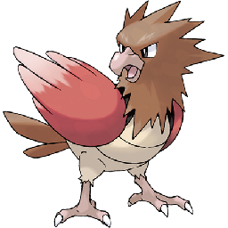
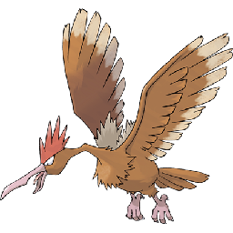
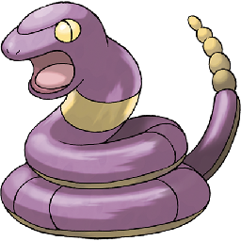
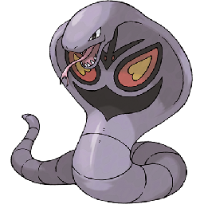


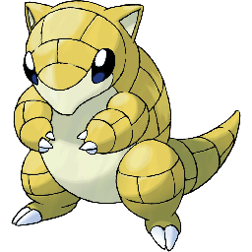



Pokedex
Pokemon vs Pokemon

Slide 3


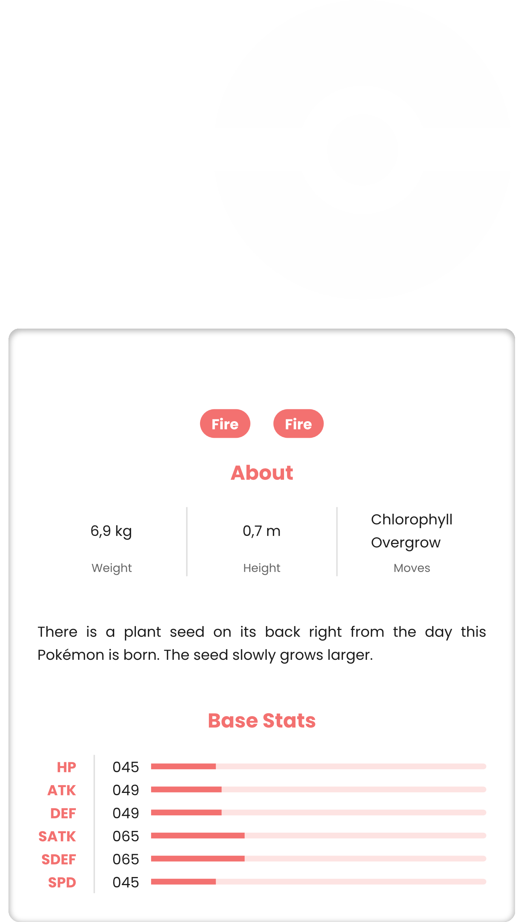

Pokedex
Pokemon vs Pokemon
Charmander
Nº 4

Slide 4
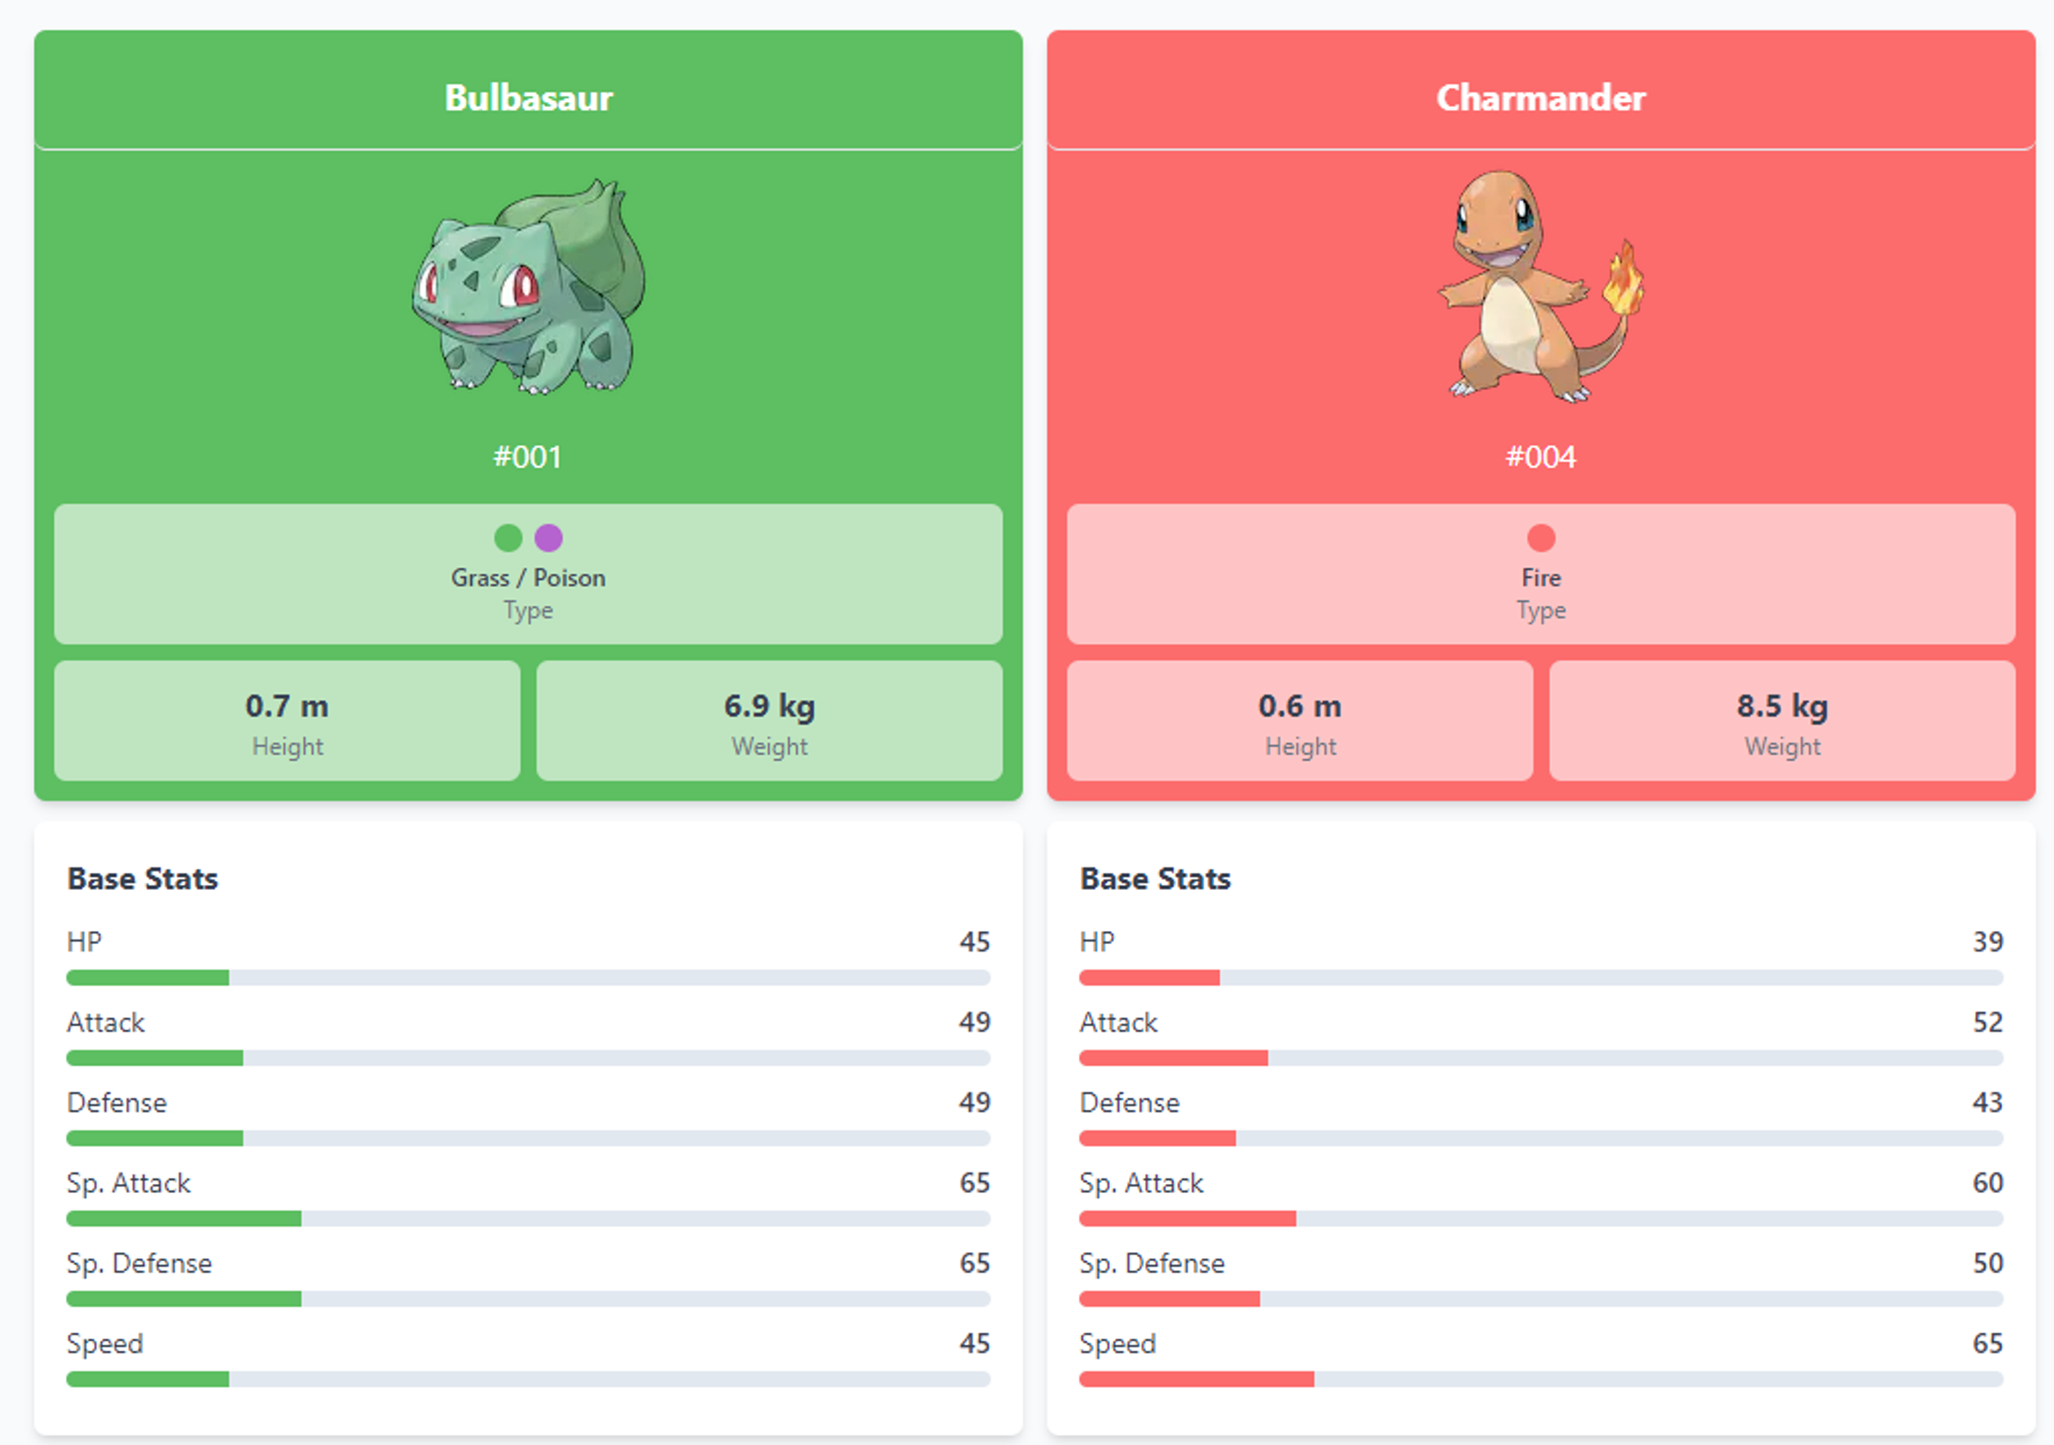
001-Bulbasaur
001-Bulbasaur
002-Ivyasaur
002-Ivyasaur
003-Venusaur
003-Venusaur
004-Charmander
004-Charmander
005-Charmeleon
005-Charmeleon
006-Charizard
006-Charizard
007-Squirtle
007-Squirtle
008-Wartotle
008-Wartotle
009-Blastoise
009-Blastoise
010-Cartepie
010-Cartepie
011-Metapod
011-Metapod
012-Butterfree
012-Butterfree
013-Weedle
013-Weedle
014-Kakuna
014-Kakuna
Charmander
015-Beedrill
015-Beedrill
Nº 4
016-Pidgey
016-Pidgey
017-Pidgeotto
017-Pidgeotto
018-Pidgeot
018-Pidgeot
019-Ratata
019-Ratata

